Slide 1

Home Building Permits Texas & The US
Aaron Eger
Christopher Stecki
Robert Allison
Jordan Tellez

Slide 2

What We Will Cover
We will be looking at the home building permits of Texas compared to the US and how we were able to use ETL to create a database to house the data.

Slide 3

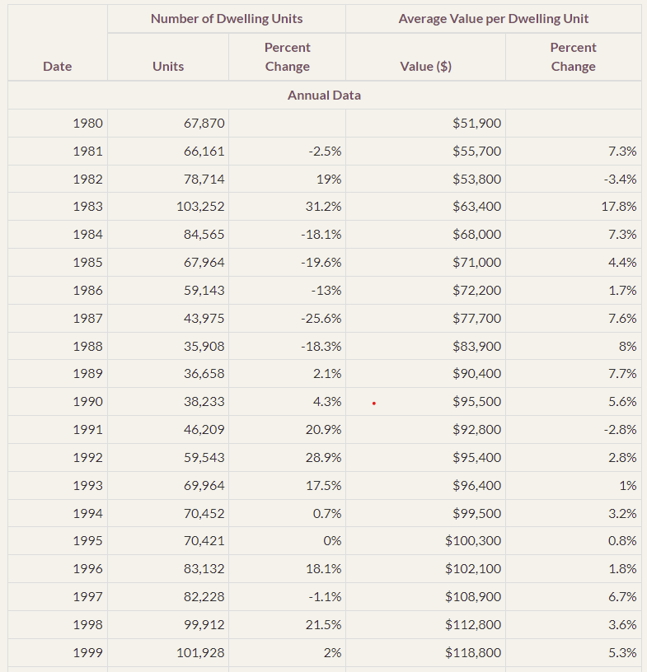
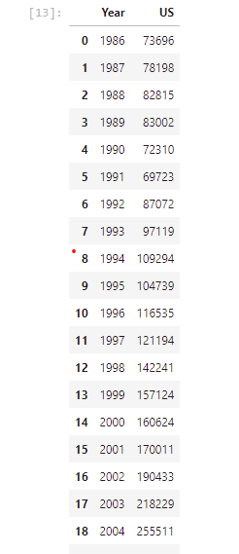
Texas Building Permits
https://www.recenter.tamu.edu/data/building-permits#!/state/Texas/

Slide 4

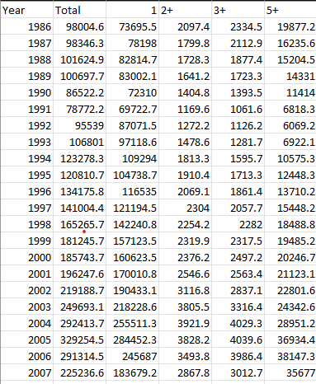
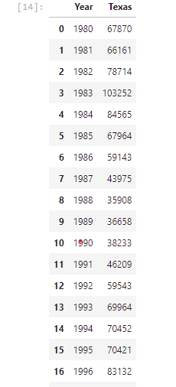
US Building Permits
https://www.census.gov/construction/bps/permitsbyusreg_cust/

Slide 5
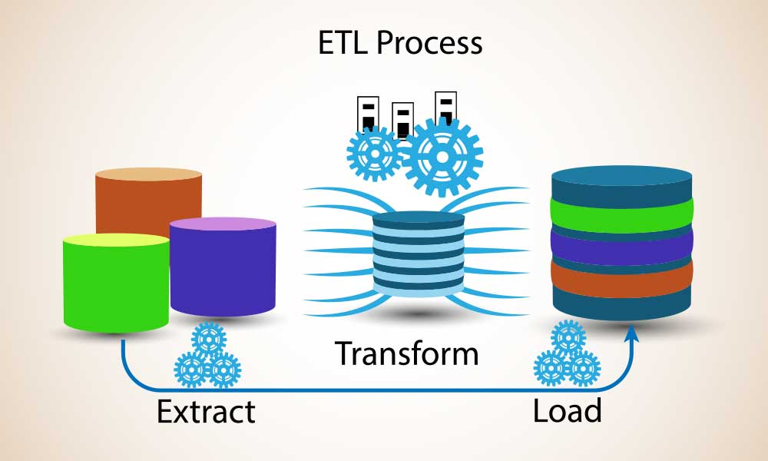

Slide 6


Extract
Extracted Texas-level tables using BeautifulSoup from the TAMU Real Estate Center
Extracted US-level via CSV sourced from the US Census
Obstacles:
Pandas was not able to read the tables directly from the web due to imbedded action keys resulting in the need for converting Pandas DataFrames from BeautifulSoup

Slide 7
Transform
US Data
Unuseful columns were limited from our CSV source We limited the data to Single Family Homes by Units of Permits per Year
Texas Data
Utilized Pandas to filter the data to comparable tables and convert DataFrames from HTML
JSON
Both DataFrames were converted to JSON dictionaries in order to be imported to MongoDB

Slide 8

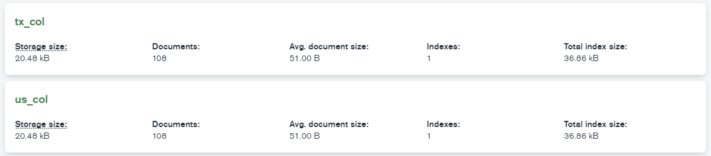
Load
Utilized PyMongo to create our database ‘permits_db’
Created two collections US and TX
Inserted our JSON dictionaries to the collections

